Slide 1
1
Slavery and the
Early Church

Slide 2
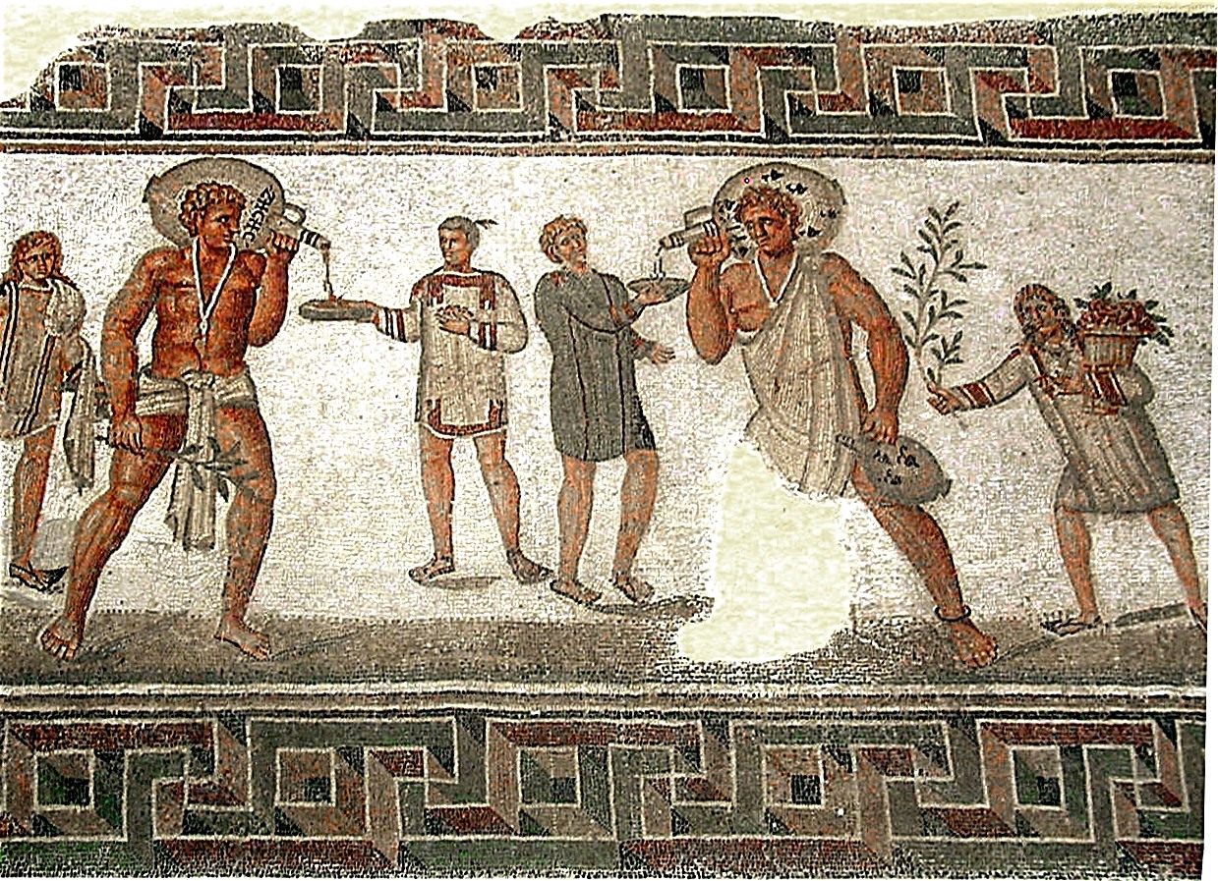
Roman mosaic from
Dougga, Tunisia (2nd Century)

Slide 3
⁵ Slaves, be obedient to those who are your masters according to the flesh, with fear and trembling, in the sincerity of your heart, as to Christ; ⁶ not by way of eyeservice, as men-pleasers, but as slaves of Christ, doing the will of God from the heart.
- Ephesians 6:5-6

Slide 4
⁷ With good will render service, as to the Lord, and not to men, ⁸ knowing that whatever good thing each one does, this he will receive back from the Lord, whether slave or free. ⁹ And masters, do the same things to them, and give up threatening, knowing that both their Master and yours is in heaven, and there is no partiality with Him.
- Ephesians 6:7-9

Slide 5
Instructions
Sincere obedience
Serve unto the Lord
Serve with a hope of blessing
Masters treat with sincerity
God will judge both slaves and masters

Slide 6
²² Slaves, in all things obey those who are your masters on earth, not with external service, as those who merely please men, but with sincerity of heart, fearing the Lord. ²³ Whatever you do, do your work heartily, as for the Lord rather than for men,
- Colossians 3:22-23

Slide 7
²⁴ knowing that from the Lord you will receive the reward of the inheritance. It is the Lord Christ whom you serve.
²⁵ For he who does wrong will receive the consequences of the wrong which he has done, and that without partiality.
- Colossians 3:24-25

Slide 8
Masters, grant to your slaves justice and fairness, knowing that you too have a Master in heaven.
- Colossians 4:1

Slide 9
Instructions
Sincere obedience
Serve the Lord
Serve with a hope of blessing
The Lord serves with you
God will punish evil slaves
Masters judge fairly
Masters have a Master in heaven

Slide 10
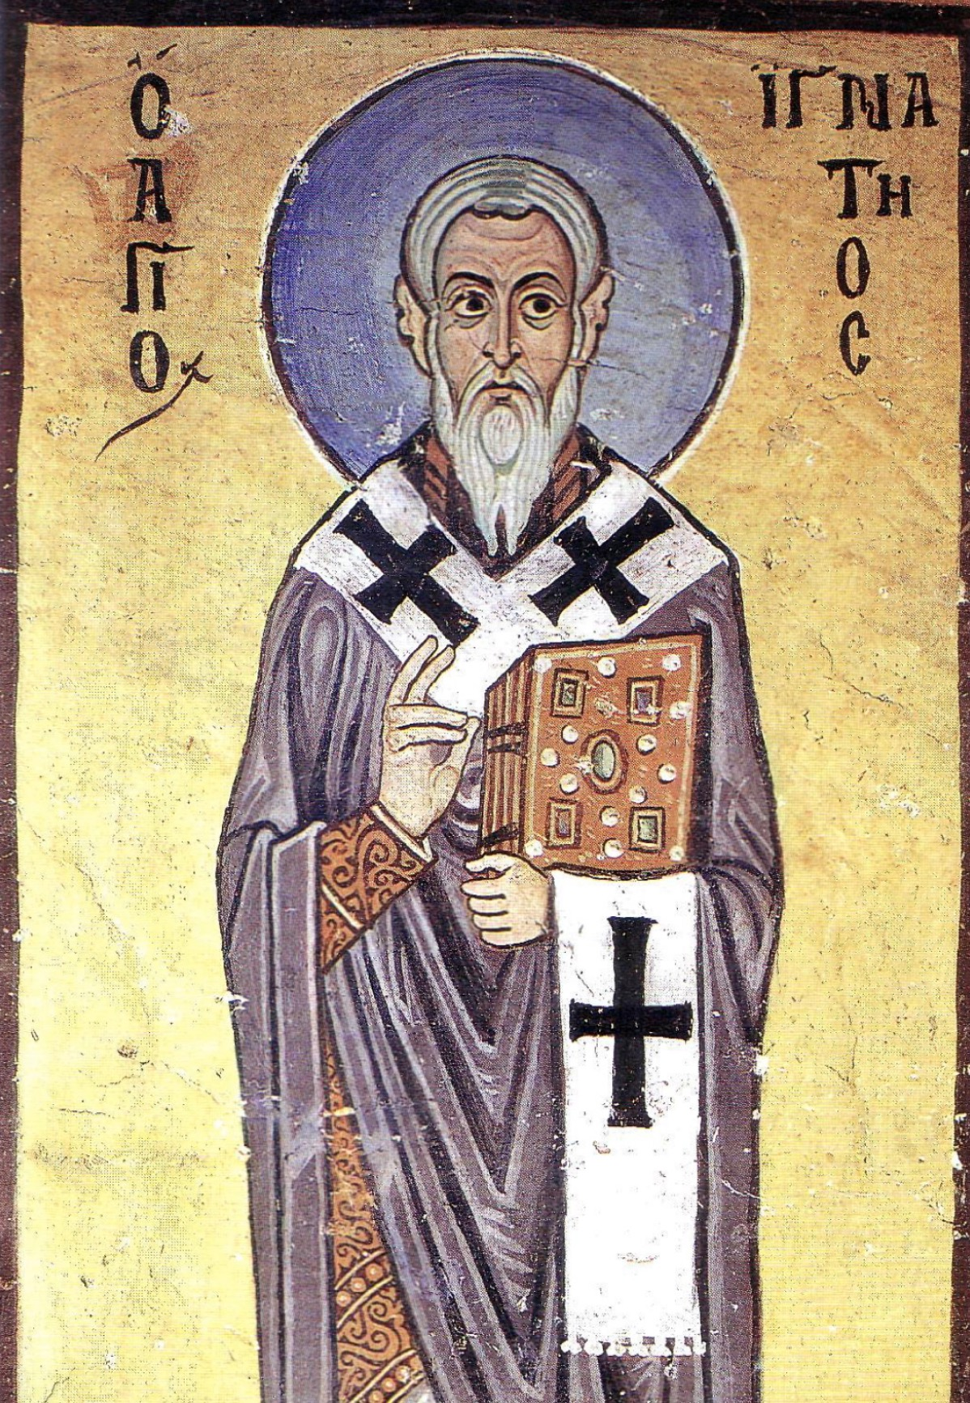
IGNATIUS
EARLY CHURCH LEADER

Slide 11
Philemon – Wealthy Christian
Onesimus – Runaway Slave

Slide 12
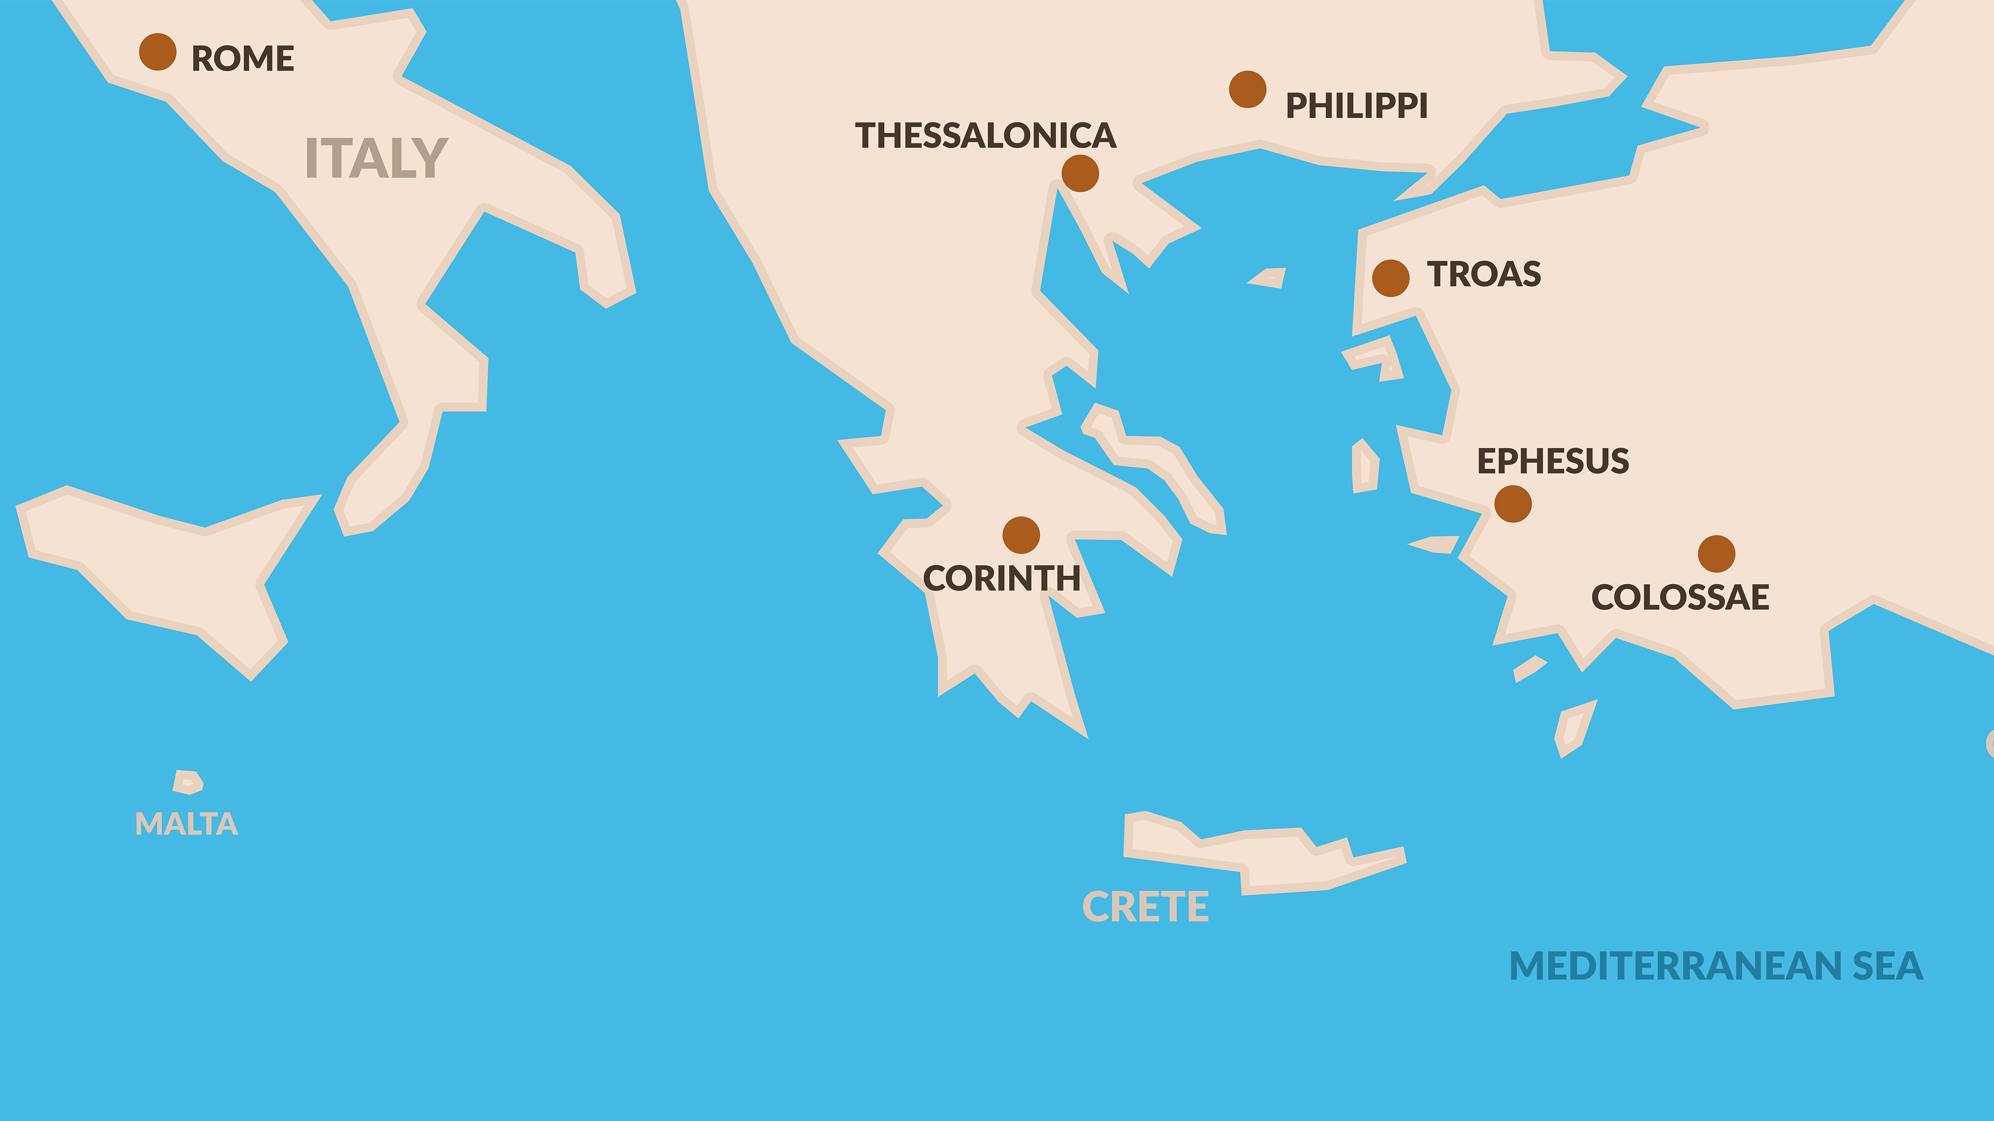

Slide 13
Three Letters (Delivered by Tychicus)
Colossian Church
Philemon
Ephesian Church

Slide 14
Philemon - Outline
Paul’s Greeting – vs. 1-3
Paul’s Prayer – vs. 4-7
Paul’s Appeal – vs. 8-20
Paul’s Request and Blessing – vs. 22-25

Slide 15
¹ Paul, a prisoner of Christ Jesus, and Timothy our brother, To Philemon our beloved brother and fellow worker, ² and to Apphia our sister, and to Archippus our fellow soldier, and to the church in your house: ³ Grace to you and peace from God our Father and the Lord Jesus Christ.
PAUL’S GREETING
- Philemon 1-3

Slide 16
Philemon – Recipient
Apphia – Philemon’s wife
Archippus – Philemon’s son

Slide 17
⁴ I thank my God always, making mention of you in my prayers, ⁵ because I hear of your love and of the faith which you have toward the Lord Jesus and toward all the saints;
PAUL’S PRAYER
- Philemon 4-5

Slide 18
⁶ and I pray that the fellowship of your faith may become effective through the knowledge of every good thing which is in you for Christ’s sake. ⁷ For I have come to have much joy and comfort in your love, because the hearts of the saints have been refreshed through you, brother.
- Philemon 6-7

Slide 19
⁸ Therefore, though I have enough confidence in Christ to order you to do what is proper, ⁹ yet for love’s sake I rather appeal to you—since I am such a person as Paul, the aged, and now also a prisoner of Christ Jesus—
PAUL’S APPEAL
- Philemon 8-9

Slide 20
¹⁰ I appeal to you for my child Onesimus, whom I have begotten in my imprisonment, ¹¹ who formerly was useless to you, but now is useful both to you and to me.
- Philemon 10-11

Slide 21
ONESIMUS = “USEFUL”

Slide 22
¹² I have sent him back to you in person, that is, sending my very heart, ¹³ whom I wished to keep with me, so that on your behalf he might minister to me in my imprisonment for the gospel;
- Philemon 12-13

Slide 23
¹⁴ but without your consent I did not want to do anything, so that your goodness would not be, in effect, by compulsion but of your own free will.
¹⁵ For perhaps he was for this reason separated from you for a while, that you would have him back forever,
- Philemon 14-15

Slide 24
no longer as a slave, but more than a slave, a beloved brother, especially to me, but how much more to you, both in the flesh and in the Lord.
- Philemon 16

Slide 25
¹⁷ If then you regard me a partner, accept him as you would me.
¹⁸ But if he has wronged you in any way or owes you anything, charge that to my account;
- Philemon 17-18

Slide 26
¹⁹ I, Paul, am writing this with my own hand, I will repay it (not to mention to you that you owe to me even your own self as well). ²⁰ Yes, brother, let me benefit from you in the Lord; refresh my heart in Christ.
- Philemon 19-20

Slide 27
Philemon’s Cost
Value of Onesimus as slave
Cost of replacing him
Damages and lost items
Social challenge

Slide 28
Having confidence in your obedience, I write to you, since I know that you will do even more than what I say.
PAUL’S REQUEST AND BLESSING
- Philemon 21

Slide 29
Onesimus eventually served as an elder at the church in Ephesus.
- Ignatius (35 AD - 108 AD)

Slide 30
²² At the same time also prepare me a lodging, for I hope that through your prayers I will be given to you. ²³ Epaphras, my fellow prisoner in Christ Jesus, greets you, ²⁴ as do Mark, Aristarchus, Demas, Luke, my fellow workers. ²⁵ The grace of the Lord Jesus Christ be with your spirit.
- Philemon 22-25

Slide 31
After being arrested for the second time in 66 AD, Paul was executed by beheading in 67 AD.

Slide 32
Lesson
Christians see life through
the eyes of faith.

